Slide 1
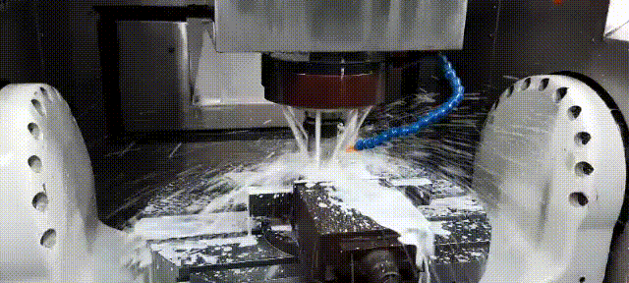
CNC
Computer Numerical Control
Lecture 26/27

Slide 2
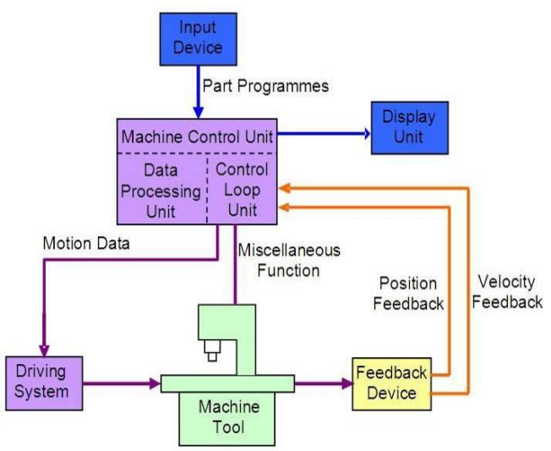
What is CNC
CNC machine is a machine that performs a subtractive manufacturing process which typically employs computerized control and machine tools to remove layer of material from a stock piece known as blank or work piece and produces custom design part by executing the computer numeric commands and languages pre-feed to the machine to perform the task with the help and guidance of various sensors.
Working Principles of CNC Machines

Slide 3
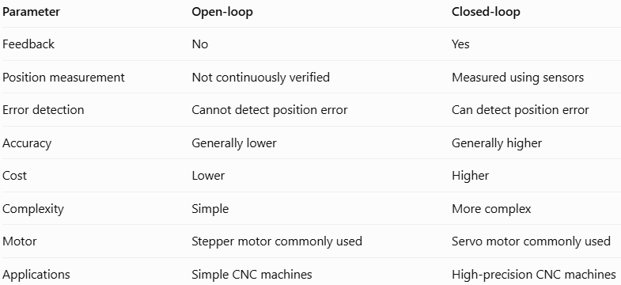
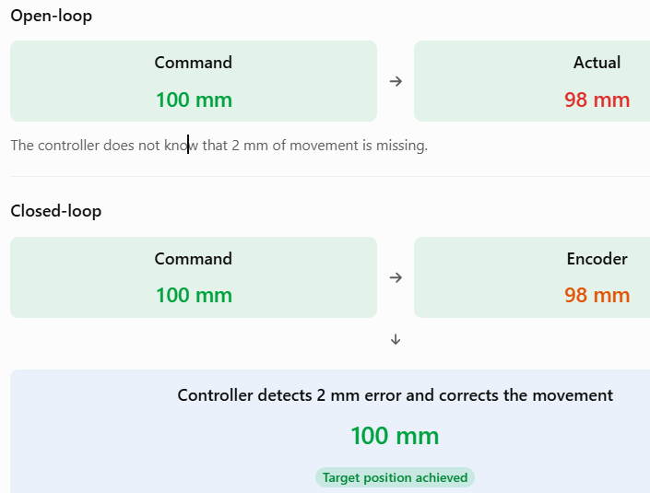
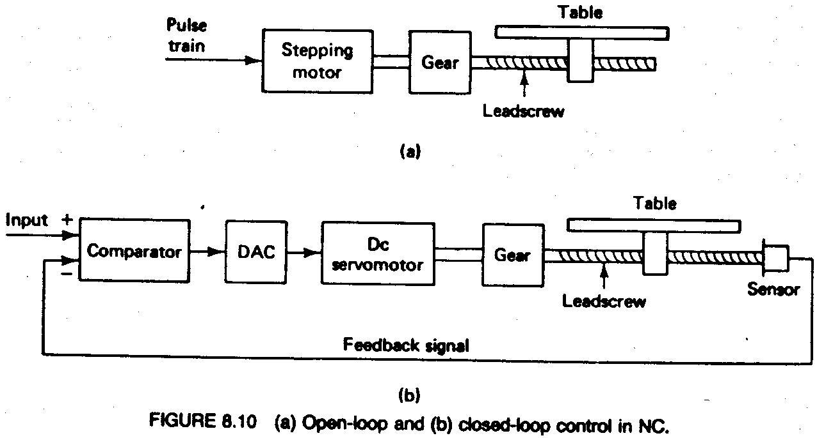
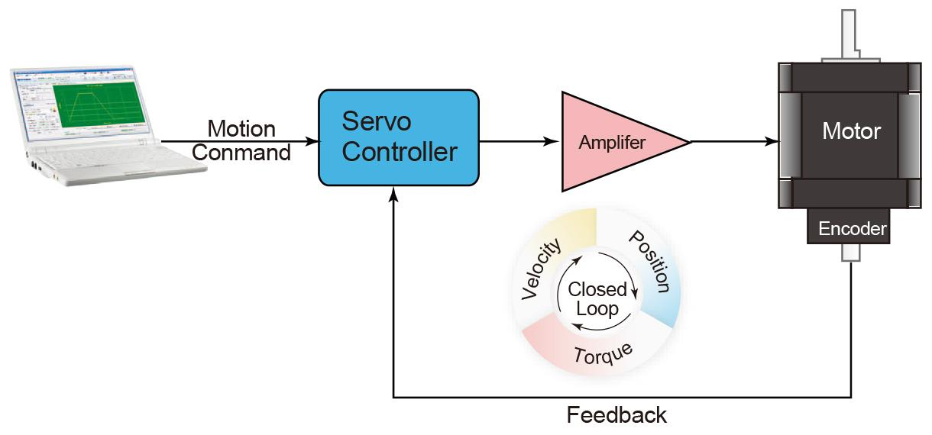
Open Loop Feedback vs Closed Loop Feedback

Slide 4
Advantages of a CNC Machine
CNC machines can be used continuously and only need to be switched off for occasional maintenance.
These machines require less skilled people to operate unlike manual lathes / milling machines etc.
CNC machines can be updated by improving the software used to drive the machines.
Once programmed, these machines can be left and do not require any human intervention, except for work loading and unloading.
These machines can manufacture several components to the required accuracy without any fatigue as in the case of manually operated machines.
Savings in time that could be achieved with the CNC machines are quite significant.

Slide 5
Disadvantages of a CNC Machine
CNC machines are generally more expensive than manually operated machines.
Increase in electrical maintenance, high initial investment and high per hour operating costs than the traditional systems.
Fewer workers are required to operate CNC machines compared to manually operated machines. Investment in CNC machines can lead to unemployment.

Slide 6
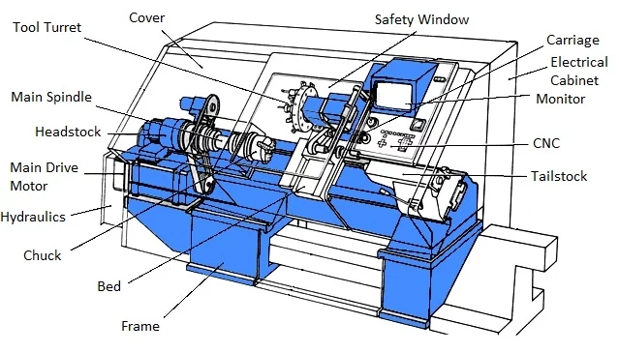
Block diagram of CNC Turning Centre
CNC Lathe: https://youtu.be/bIlKcYNenfk

Slide 7
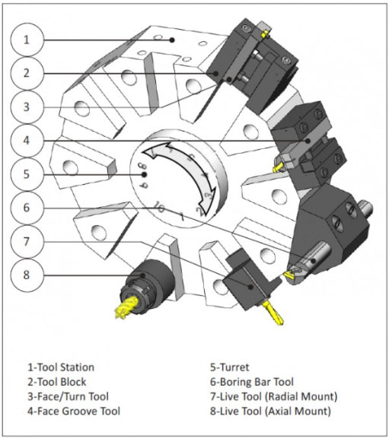

Slide 8
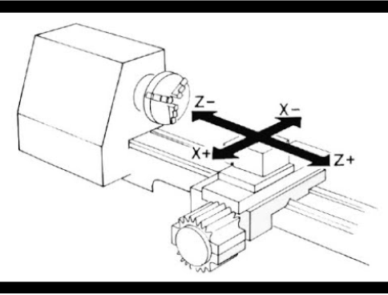
Axis in CNC Lathe

Slide 9
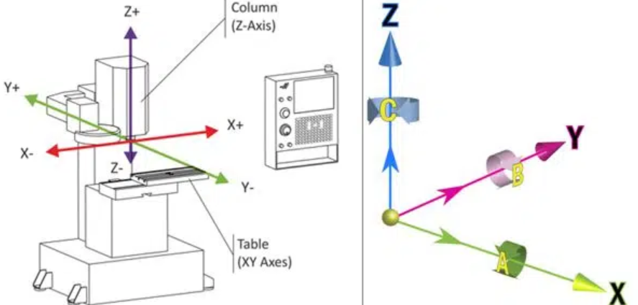
Axis in CNC Milling

Slide 10
Programming Fundamentals
Machining involves an important aspect of relative movement between cutting tool and workpiece.
In machine tools this is accomplished by either moving the tool with respect to workpiece or vice versa.
In order to define relative motion of two objects, reference directions are required to be defined.
These reference directions depend on type of machine tool and are defined by considering an imaginary coordinate system on the machine tool.
A program defining motion of tool / workpiece in this coordinate system is known as a part program.

Slide 11
Types of CNC codes
Preparatory codes:
The term "preparatory" in NC means that it "prepares" the control system to be ready for implementing the information that follows in the next block of instructions. Preparatory functions are also called G-codes and they specify the control mode of the operation.
Miscellaneous codes:
Miscellaneous functions use the address letter M followed by two digits. They perform a group of instructions such as coolant on/off, spindle on/off, tool change, program stop, or program end. They are often referred to as machine functions or M-functions.
In principle, all codes are either modal or non-modal.
Modal code stays in effect until cancelled by another code in the same group. The control remembers modal codes. This gives the programmer an opportunity to save programming time. (G00,G01 etc.)
Non-modal code stays in effect only for the block in which it is programmed. Afterwards, its function is turned off automatically. (M06, M00, G28)

Slide 12
G-Codes: Controls the movement and path of the tool
G00 – Rapid positioning
G01 – Linear interpolation (Cutting move)
G02/G03 – Circular motion (CW/CCW)
G20/G21 – Inch/mm programming
G28 – Return to machine zero
G54- WCS (home)
G90/G91 – Absolute vs Incremental
G94 – Feed per minute
G95 – Feed per revolution
G17- select XY plane (milling)
G40- Cancels cutter radius compensation
G41/G42-Activates cutter radius compensation to the left/right of the programmed tool path

Slide 13
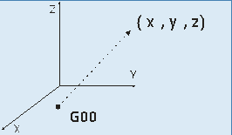
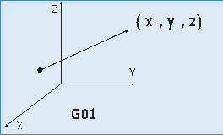
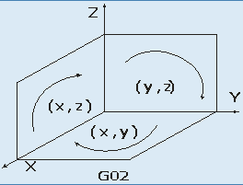
Tool motion
Command Group | G-Code | Function and Command Statement | Illustration
Tool motion | G-00 | Rapid traverse G00 Xx Yy Zz; Ex: G00 X10 Y5 Z-3;
 | G-01 | Linear interpolation G01 Xx Yy Zz Ff;
 | G-02 | Circular Interpolation in clock-wise direction G02 Xx Yy Rr; G02 Xx Zz Rr; G02 Yy Zz Rr;

Slide 14
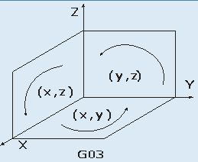
Tool motion
Command Group | G-Code | Function and Command Statement | Illustration
Tool motion | G-03 | Circular interpolation in counter- clockwise directionG03 Xx Yy Rr G03 Xx Zz Rr G03 Yy Zz Rr

Slide 15
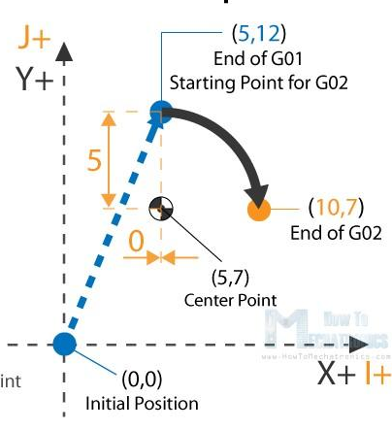
G02 X10 Y7 R5
Circular motion clockwise
Set end points
G02 X10 Y7 I0 J-5
X and Y offsets are relative to starting point
X offset to center point
X offset to center point

Slide 16
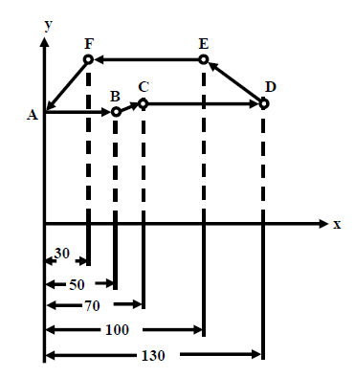
Programming modes
Absolute Systems(G90)
In absolute programming, all measurements are made from the part origin established by the programmer and set up by the operator. Any programmed coordinate has the absolute value in respect to the absolute coordinate system zero point. The machine control uses the part origin as the reference point in order to position the tool during program execution.
Example: In an incremental system, the motion parameters, along the X-axis, for the segments, A-B, B-C, C-D, D-E, E-F and F-A, would be given as, 50, 20, 60, -30, -70 and –30, respectively.
Figure: A trajectory for drilling
Incremental System(G91)
In incremental programming, the tool movement is measured from the last tool position. The programmed movement is based on the change in position between two successive points. The coordinate value is always incremented according to the preceding tool location. The programmer enters the relative distance between current location and the next point.

Slide 17
M-Codes: Controls machine operations
M00 – Temporary Program stop
M03/M04 – Spindle ON (CW/CCW)
M05 – Spindle OFF
M06 – Tool change
M08/M09 – Coolant ON/OFF
M30 – End program & rewind

Slide 18
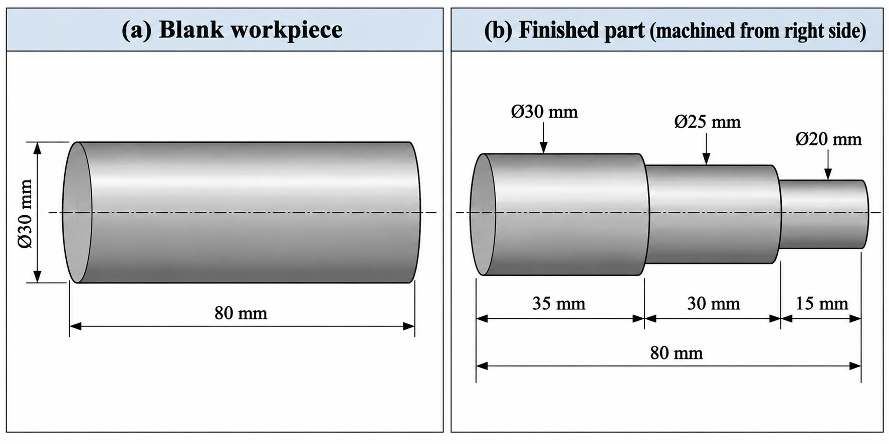
Maximum depth of cut can be taken as 2 mm

Slide 19
G21 G90 G95
G28 U0 W0
T01 M06
M03 S800
G54 X0 Z0
G00 X32 Z2
G00 X26
G01 Z-45 F0.3 #Roughing
G01 X32
G00 Z2
G00 X25 #Finishing
G01 Z-45 F0.2
G01 X32
G00 Z2
G01 X21 F0.3 #Roughing
G01 Z-15
G01 X32
G00 Z2
G01 X20 F0.2 #Finishing
G01 Z-15
G01 X32
G00 Z2
M05
G28 U0 W0
M30
80
30

Slide 20
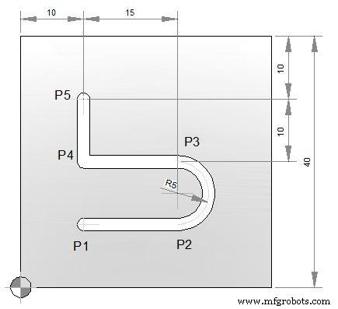
G21 G90 G94 (measurements in mm, Abs Coord Sys, feed in mm/min)
G28 U0 V0 W0 (return to machine zero)
T01 M06 (selecting the 1st tool in the tool magazine/turret)
G17 G54 (selecting the XY plane for machining in milling)
G00 X0 Y0 Z5 (rapid movement to safe point, no machining involved)
M03 S800 (spindle rotation clockwise with 800 RPM)
G00 X10 Y10
G01 Z-2 F200
G01 X25 Y10
G03 X25 Y20 R5 or
G01 X10
G01 Y30
G01 Z2
M05 (spindle off)
G28 U0 V0 W0 (return to machine zero)
M30 (program end and rewind)
G03 X25 Y20
I0 J5
(0,0)
P1 (10,10)
P2 (25,10)
P3 (25,20)
P4 (10,20)
P5 (10,30)

Slide 21
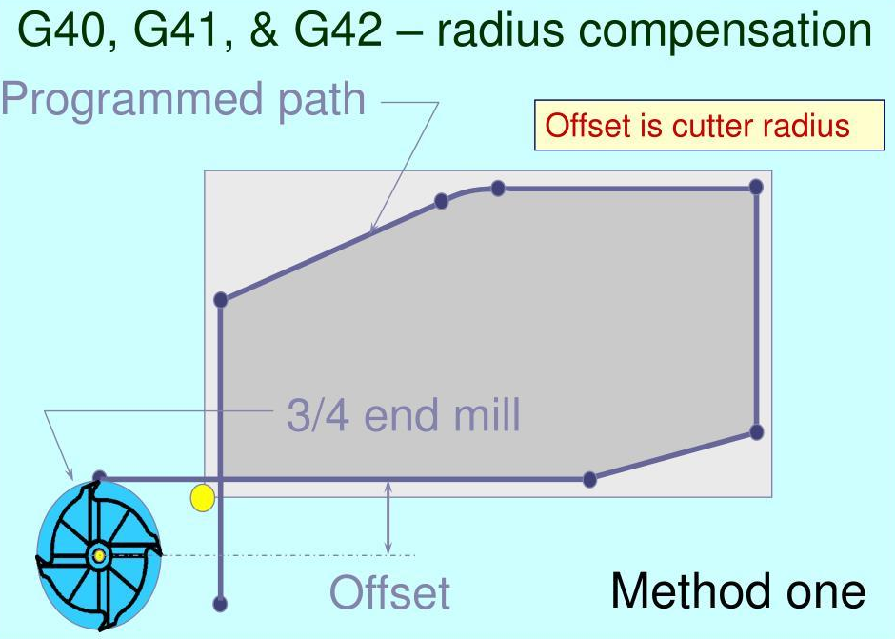

Slide 22
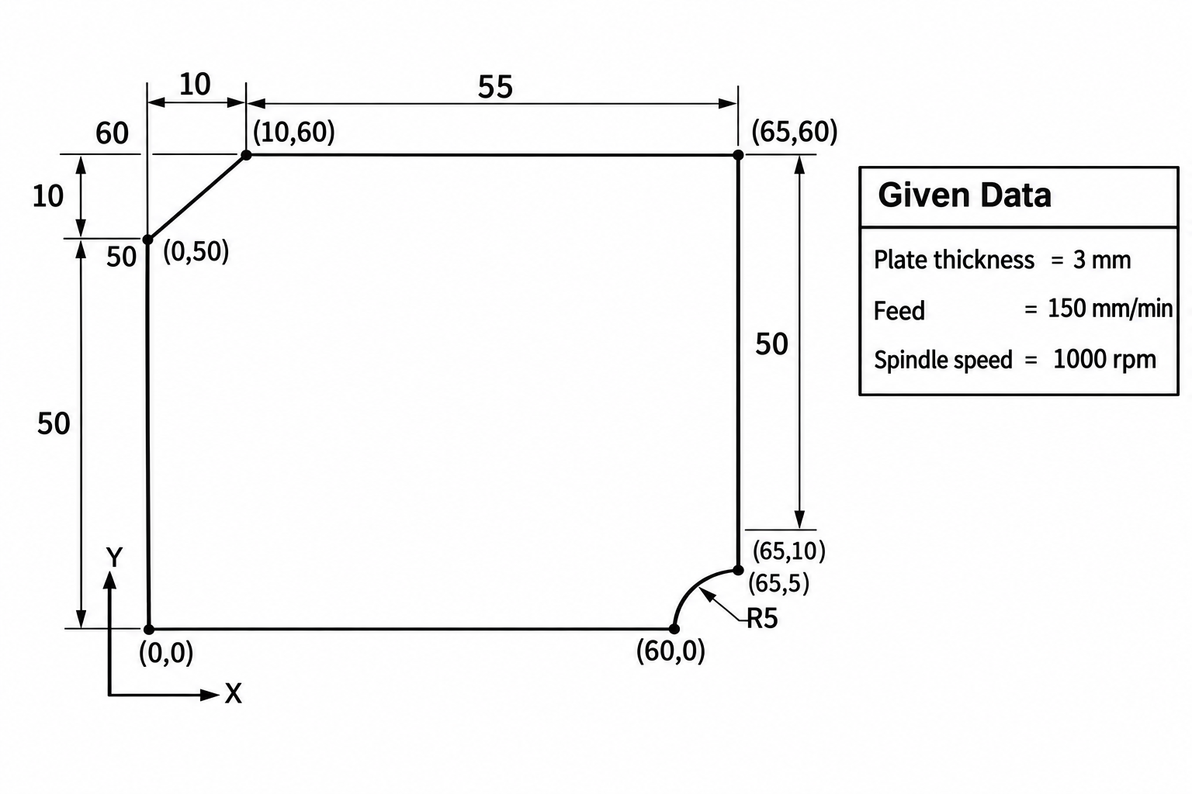
O0003
N10 G21 G17 G90 G40;
N20 G28 U0 V0 W0;
N30 T01 M06;
N40 G54 S1000 M03;
N50 G00 X0 Y0 Z5;
N60 G41D01;
N70 G00 X0 Y50;
N80 M08;
N90 G01 Z-5 F150;
N100 G01 X10 Y60;
N110 G01 Z5;
N120 G00 X65 Y5;
N130 G01 Z-5;
N140 G03 X60 Y0 R5;
N150 G01 Z5;
N160 M09;
N170 M05;
N180 G28 W0;
N190 G28 U0 V0;
N200 M30;

Slide 23
References
[1] https://nptel.ac.in/content/storage2/courses/108105063/pdf/L-23(SM)%20(IA&C)%20((EE)NPTEL).pdf Nptel note by IIT Kharagpur, Module 5, CNC Machines [2] Nptel lecture by Prof. Madhusudan Rao, https://nptel.ac.in/courses/112/102/112102103/ Kindly access the CNC videos from the links below. CNC Lathe: https://youtu.be/bIlKcYNenfk CNC mill: https://youtu.be/SdkTDRNw2ls

Slide 24
Thank You

